Slide 1
Handling Data Annotation Uncertainty in Human Activity Recognition
Hyeokhyen Kwon, Gregory Abowd, Thomas Plotz

Slide 2
Motivation
Data Collection and Annotation are important!
Most HAR models used a discrete data labeling scheme
But even the most reliable annotator can get it wrong
Exact activity transition points are hard to determine
Activity can overlap each other
Label jitter: uncertainty region at the start/end of an activity (activity boundary)
-> Label jitters can prevent the HAR model from achieving ideal performance

Slide 3
Past attempts
Discrete label correction
Ignorance is bliss!
Majority voting among multiple annotators
Iteratively shift label to refine annotation (EM method, Fukunaga Class-Separability)
Soft label fusion
Use multiple annotators -> subjectivity and uncertainty
Labels are represented as multinomial distribution of activities
Uniform contribution
Assign weights based on reliability
Label augmentation: Incorporate noise into the dataset to regularize models

Slide 4
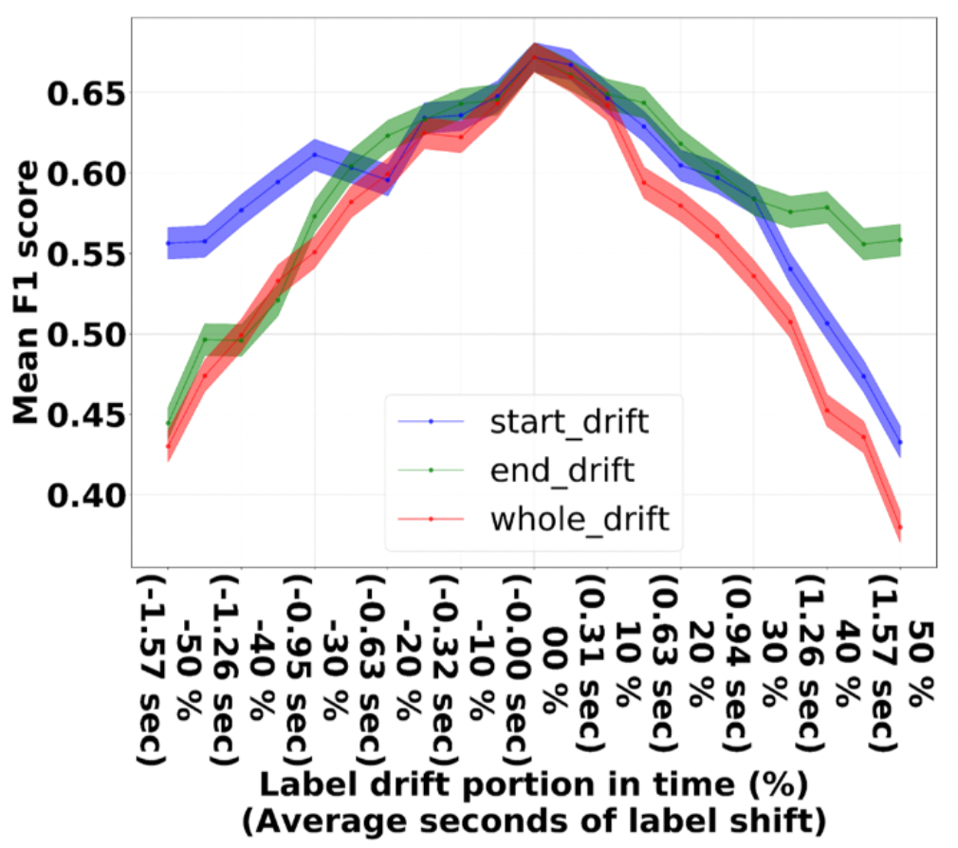
Effects of Label Misalignment on HAR models
Experiment:
Opportunity dataset, ConvLSTM model
Shift the labels at the start/end/both of the boundary
Amount of shifting is proportional to the length of the activity (max 50%)
Effects on the F1 score shown in the plot on the right

Slide 5
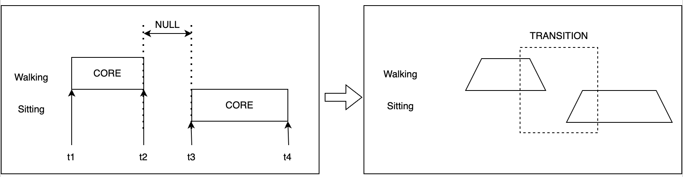
Adaptive Smooth Activity Transition (SAT)
CORE interval: middle section of an activity, essence of the motions
NULL interval: where nothing “interesting” happen
Event boundaries: Start/End-points of an activity
Perspectives:
Label jitter is unlikely at CORE interval
Activity Transition (TR) uncertainty inversely proportional to activity length
Overlapping (OV) uncertainty is inversely proportional to NULL interval length

Slide 6
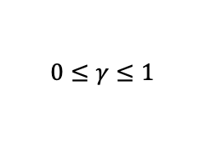

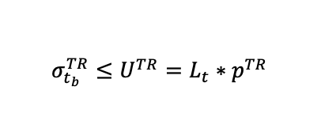
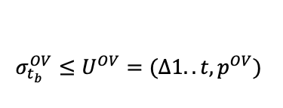

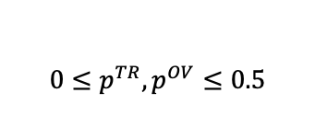


Adaptive Smooth Activity Transition (SAT)
Derive the smoothing kernel based on the observations:
$$P\left(t_{b}\right)=γ𝒩\left(t_{b}, σ_{t_{b}}^{TR}\right)+\left(1 −γ\right)𝒩\left(t_{b}, σ_{t_{b}}^{OV}\right)$$
$$σ_{t_{b}}^{TR}=\frac{α}{L_{t}} and σ_{t_{b}}^{OV}=\frac{β}{∆_{t}}$$
Constraint:
Variables:
∆ is the length of the NULL interval

Slide 7
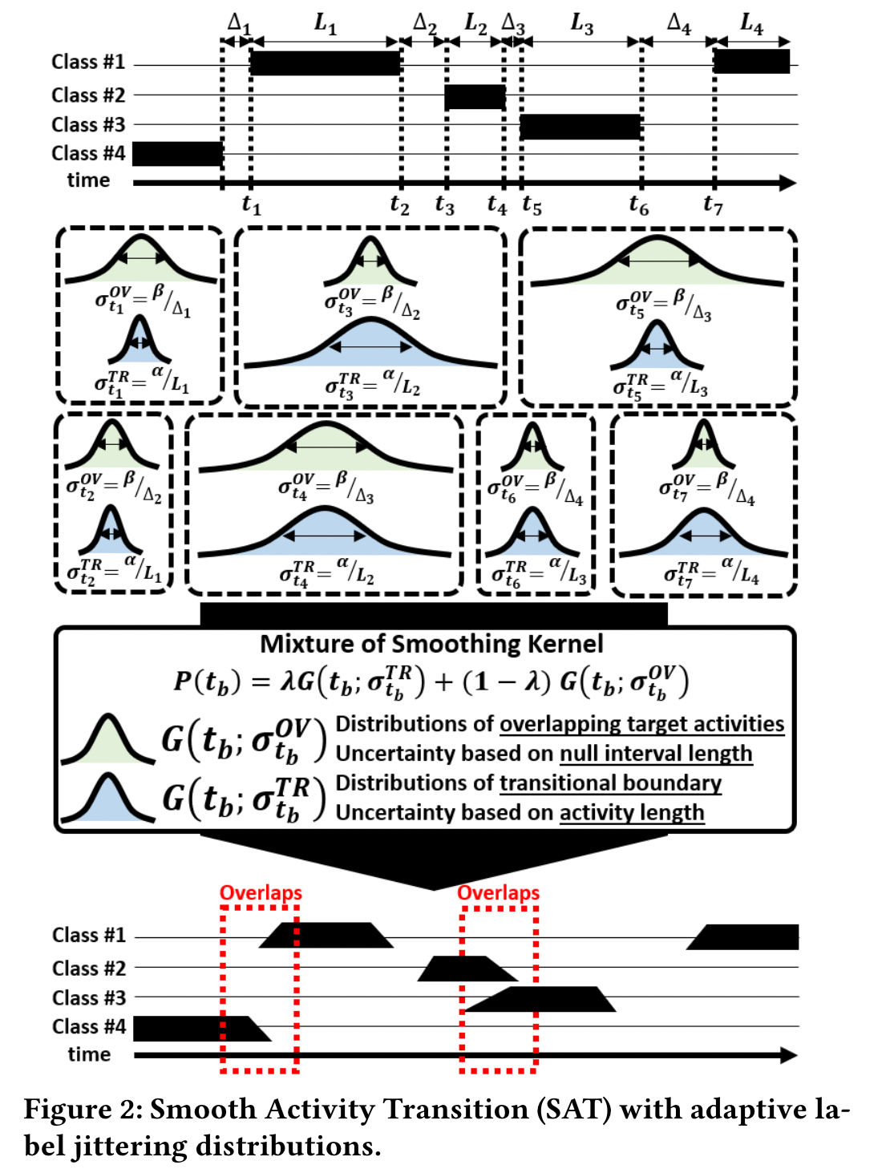
Smooth Activity Transition
Finally, we use P(t) as the kernel to smooth activity boundary at timestep t.
How can we use SAT with classifiers?
Classifiers that work with soft labels: fuzzy SVM, softmax classifier, …
Discrete classifiers: augment the dataset by sampling from the uncertainty distribution

Slide 8
Evaluation Procedure
Datasets: Opportunity, Daphne Gait, Wetlab, 50salads
Metrics: F1 score, Wilson score interval, misalignment analysis, …
Models: Random Forest (RF), Conv, ConvLSTM
Labels: baseline (remove the uncertainty), SAT-OV, SAT-TR, SAT

Slide 9
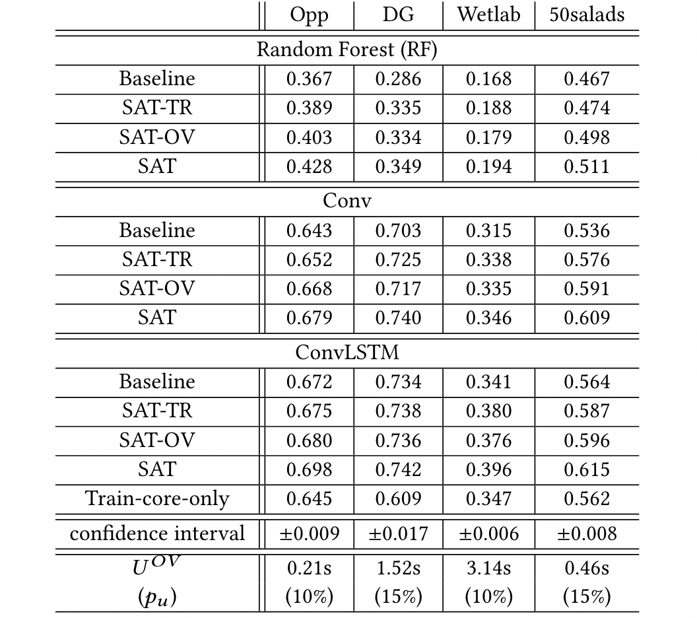
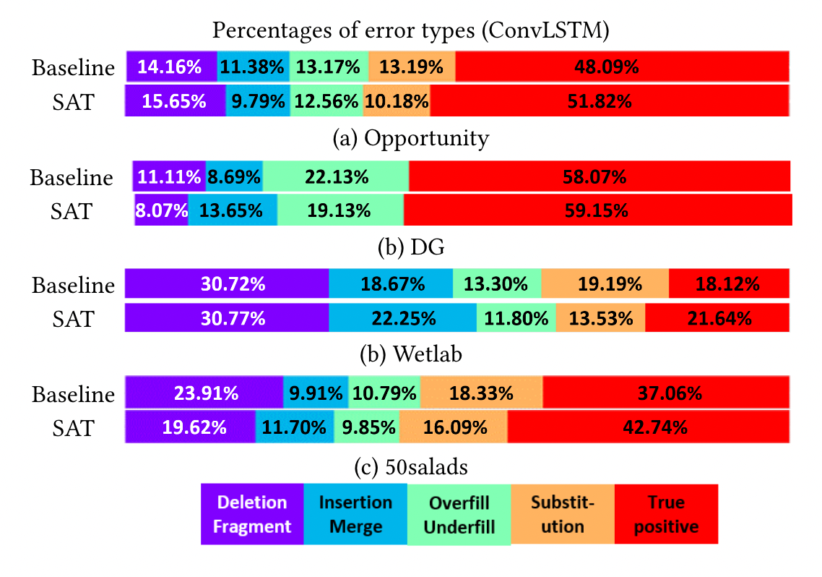
Results
Misalignment Analysis
Mean F1 score
Notes:
RF’s performance has the biggest improvement (F1 mean score)
Deep neural networks seems to learn some feature representation that adapts to the uncertainty of the label space up to certain degree.
Misalignment analysis: SAT decrease substitution error and boundary errors (over/underfill) -> which is the main point of SAT

Slide 10
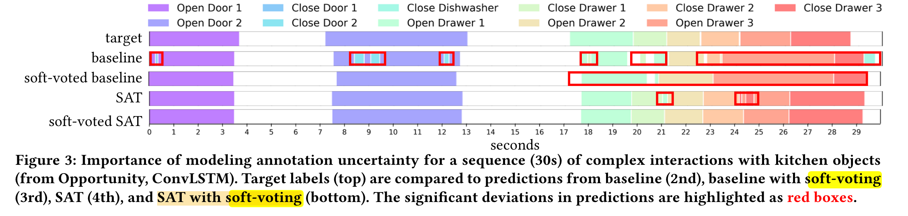
Results
Examining SAT compatibility with post-hoc label errors correction
Apply soft-voting filter to the baseline/SAT labels
The filter removes sequence of activities in the baseline case
The filter do minor adjustments on the SAT case, results in a sequence nearly identical to the target.
Notes:
We want to investigate if SATis complementary with post-hoc correction of errors in the prediction outputs.
The soft-voting filter’s window size is set to 2.5seconds
Apply soft-voting on the baseline remove sequences in the baseline.
Soft-voting works well with SAT (only remove minor errors) -> the results is nearly identical to the target

Slide 11
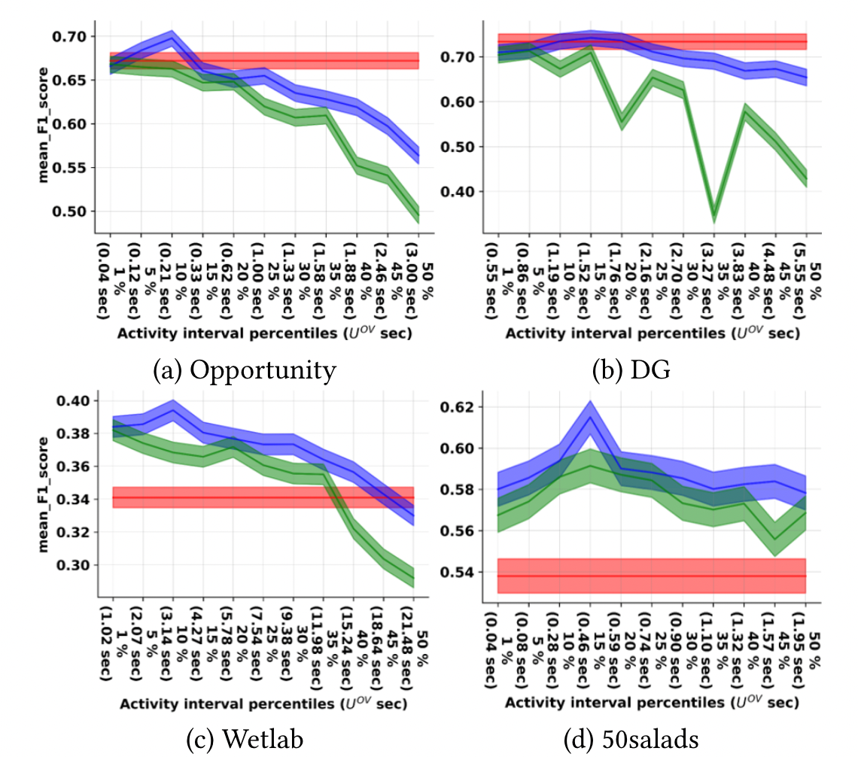
Effects of Adaptive Label Jitter Modeling
Compare SAT with a fixed-size label jitter (uniform smoothing):
Uniform smoothing works for dataset with large uncertainty
Uniform smoothing underperforms the baseline in dataset with short activities/NULL intervals
Notes:
for the uniform smoothing, the authors fixed the variance of overlapping uncertainty to U^OV, while in the SAT, U^UV is used as an upperbound

Slide 12
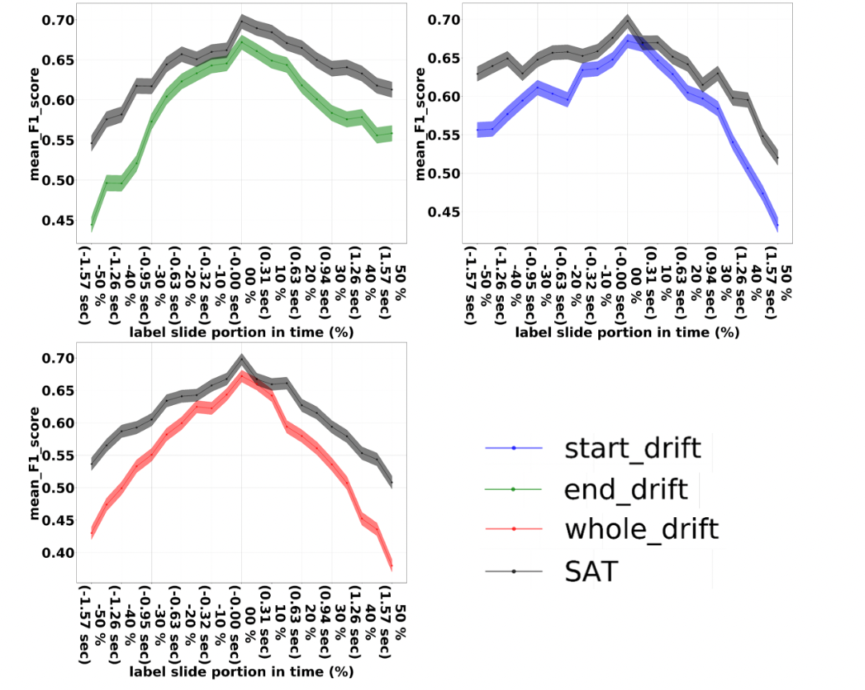
Robustness Under Label Shift

Slide 13
Conclusion
Create a scheme to incorporate label uncertainty into model training
Dynamic label jitter smoothing significantly increases model performances on various datasets
Adaptive SAT is shown to reduce boundary errors and substitution errors
Future research:
Does uncertainty boundary depend on activity classes?
Does long-term context influence annotation behaviors?

